Slide 1
Optical Tweezers: Measuring the Piconewton Forces
PHYS5381 Final Presentation
Runze Shi; April 3th, 2026
Department of Physics
College of Science
Northeastern University

Slide 2
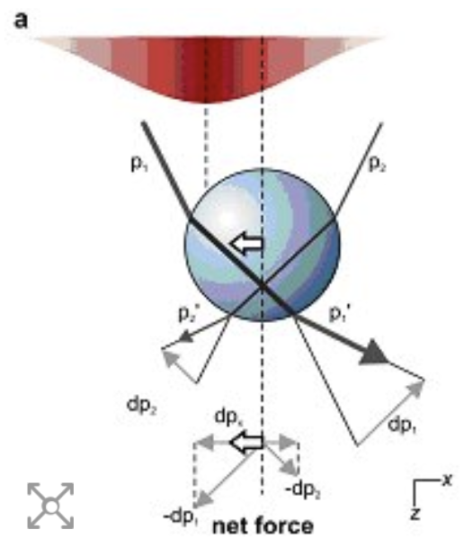
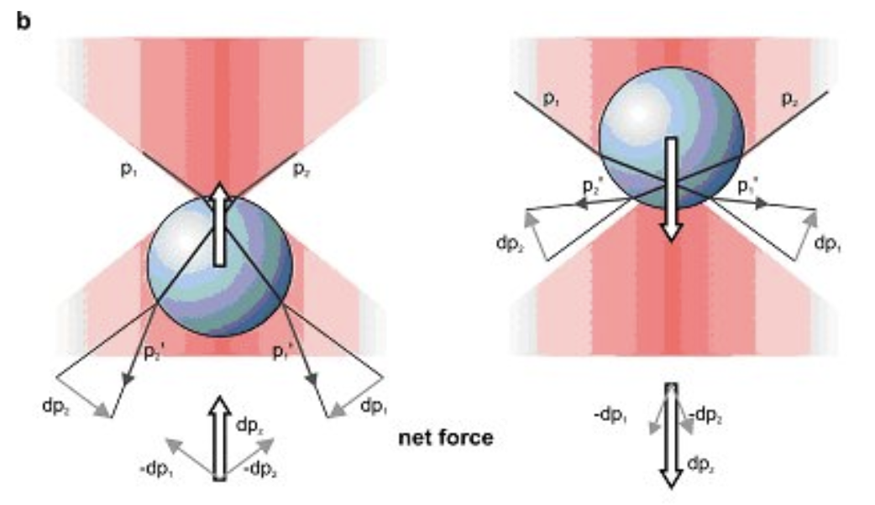
Motivation
History, Mechanisms, Application.
First demonstrated by Arthur Ashkin in 1986
Essential in biophysics Research.
Elasticity of DNA
Stepping of molecular motors
Induced force near the focal point due to intensity gradient.
Restores for small displacement from the equilibrium position.
https://physicsworld.com/a/optical-tweezers-where-physics-meets-biology/
Notes:
The optical Tweezers was first demonstrated by Arthur Askin in 1986.
Since the discovery and demonstration of this technique, it has been an essential tool in the experimental biophysics research field, with the application such as,
Using it to understand the Elasticity of the DNA
Stepping of the molecular motors
How this tweezers works is
When a dielectric particle with refractive index greater than the surrounding
medium is placed near the focus of a laser beam, the intensity gradient (or the change of momentum) induces a restoring force directed toward the focal point, forming a stable three-dimensional trap.

Slide 3
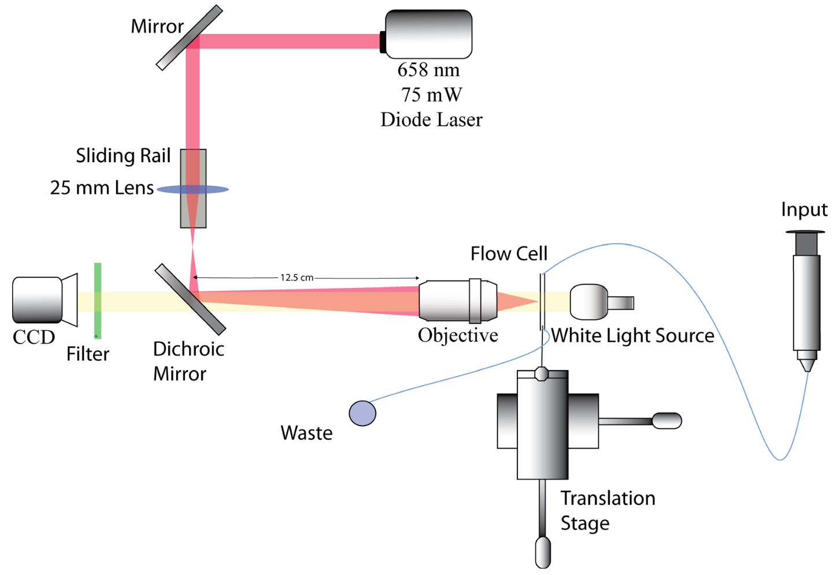
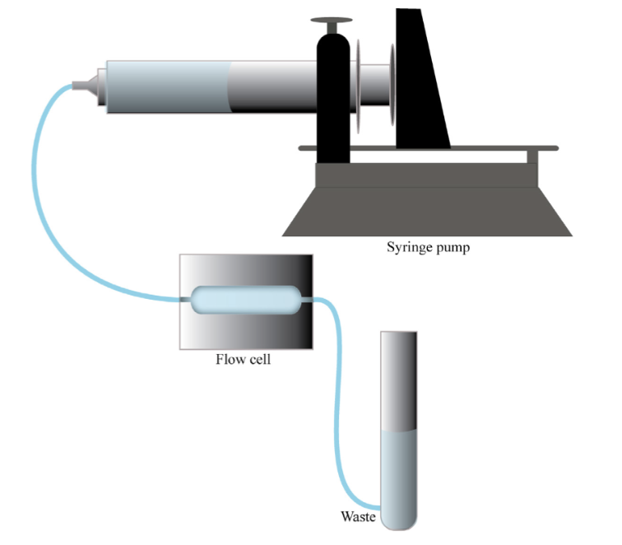
Material and Methods
The experimental setup
Notes:
The trapping laser is a 658 nm, 75 mW diode laser, whose beam is directed through two laser-line mirrors designed to reflect light in a narrow band around 633 nm.
Between the two mirrors, a convex lens mounted on a sliding rail expands the beam diameter to fill the back focal plane of the microscope objective, maximizing the trapping force.
The expanded beam is then focused by a high numerical aperture oil-immersion objective into the flow cell to form the optical trap.
Imaging was performed by a CCD camera positioned behind adichroic mirror, illuminated by a blue LED placed on the opposite side of the flow cell.
The flow cell consists of a Plexiglas spacer with two glass cover slips bonded to each side, forming a sealed chamber with an input and output tube.
Prior to mounting, the cell was filled with deionized water and inspected to ensure all air bubbles were removed from the tubing and valve system.
A drop of immersion oil was applied between the objective and the cell to satisfy the optical requirements of the oil-immersion objective.
The flow rate of liquid through the cell was controlled by a syringe pump, which allowed precise adjustment of the volumetric flow rate.

Slide 4
Material and Methods
The experimental setup
Bead: trapped particles
Diameter of 4.16 ± 0.21 µm
Index of refraction n = 1.50
Deionized water n = 1.33
Notes:
The trapped particles were polystyrene microspheres with a diameter of 4.16 ±0.21 µm and index of refraction n= 1.50, suspended in deionized water (n= 1.33).
The refractive index contrast between the bead and the surrounding medium is the physical origin of the trapping gradient force. A small volume of bead solution was introduced into the flow cell once the optical trap was confirmed to be positioned inside the cell.

Slide 5
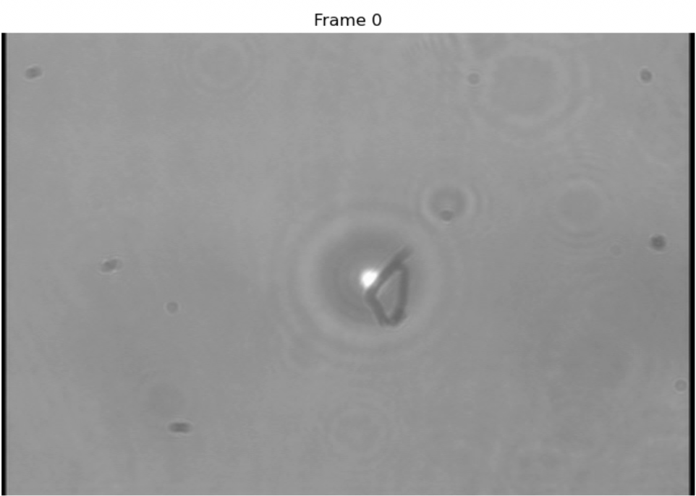
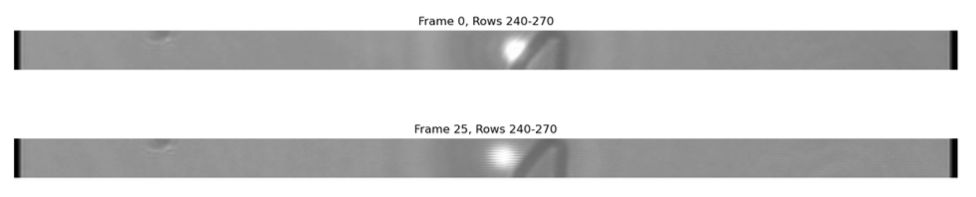
Material and Methods
Data Acquisition
Measurements were taken at
25, 50, 75, 120, 125, 130, 135, 145 µL/min.
Python with the OpenCV, NumPy, and SciPy libraries.
A region of interest (ROI): rows 240-270 was selected, as it trapped bead and optical trap center
Notes:
Video files were analyzed using Python with multiple video analysis libraries. Each frame was
converted to grayscale and a region of interest (ROI) spanning rows 240–270 was selected to isolate the bead.
The pixel-to-physical-unit scale was calibrated by measuring the bead diameter in pixels from an intensity profile and applying:
pixel size = 4.16 µm (bead width)/pixels
Bead position in each frame was determined by locating the peak of a Gaussian-smoothed (σ = 5 pixels) inten-sity profile. Outliers in the position time series were re-
moved using Z-score thresholding (threshold: 2σ), with
outlier values replaced by the series median. The range
of motion of the trapped bead was computed as the dif-
ference between the maximum and minimum positions in
the cleaned time series. For freely flowing beads, veloc-
ity was computed by tracking the bead centroid across

Slide 6
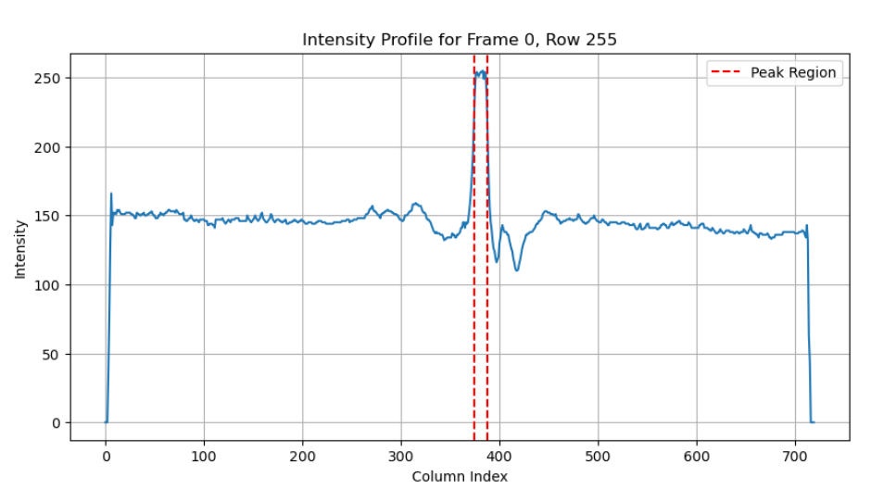
Material and Methods
Data Acquisition
Intensity threshold
Intensity Background: 25th percentile of distribution
Notes:
The calibration procedure was as follows: An intensity profile was extracted from a single row within the selected region of interest.
The background intensity level was determined as the 25th percentile of the intensity
distribution.
A threshold intensity was set at 50% of the distance between background and peak intensity. Pixels exceeding this threshold were identified as part of the bead.

Slide 7
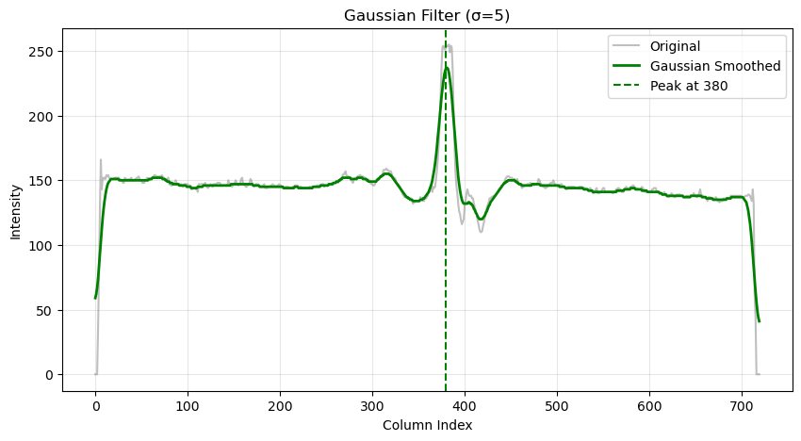
Results
Data analysis
Notes:
The position of peak intensity in this profile represents the center position of the trapped
bead. To improve the precision of peak detection and reduce noise, each raw intensity profile was smoothed using a Gaussian filter with standard deviation σ = 5 pixels before finding the maximum. The maximum intensity position was recorded for each frame, yielding a time series of bead positions with one measurement per frame (30 Hz sampling rate)

Slide 8
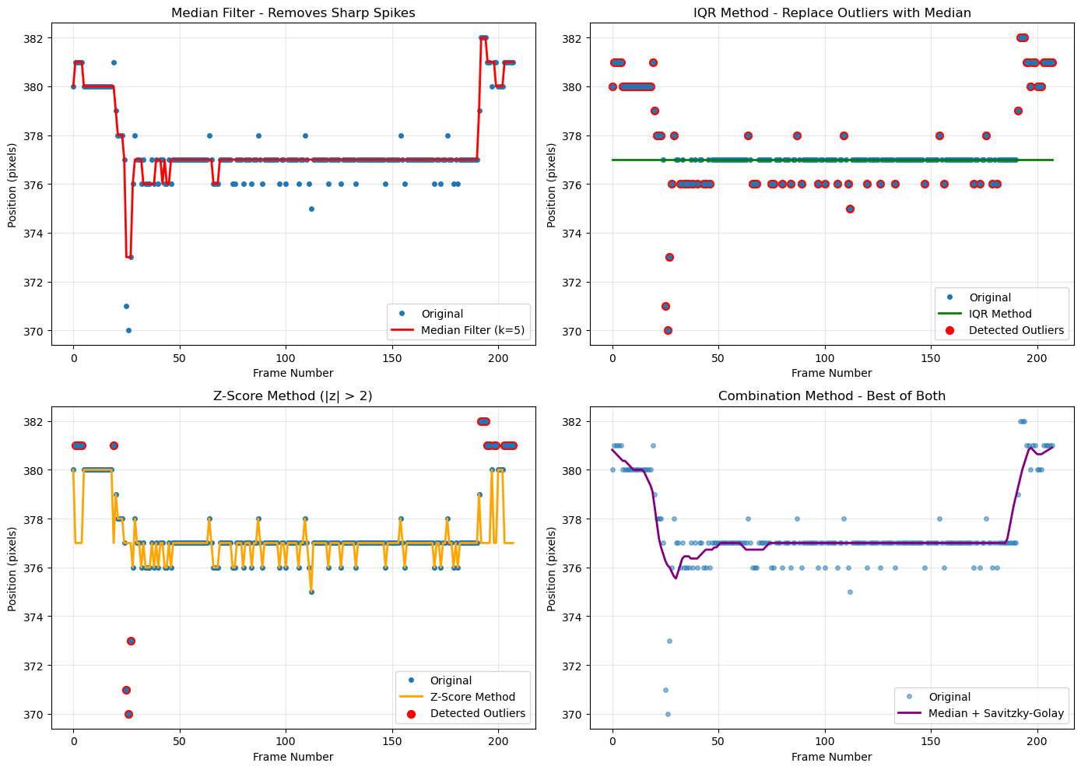
Results
Data analysis
Median Filter
IQR Method
Z-Score
Combined
Notes:
The raw position time series typically contained spurious outliers caused by noise and temporary loss of bead tracking. Several outlier removal methods were tested: (1) median filtering, (2) interquartile range (IQR) method, (3) Z-score thresholding.
The Z-score method was selected for the primary analysis due to its robust statistical basis. In this method, points more than 2 standard deviations away from the mean were identified as outliers. Outlier values were replaced with the median of the position time series to preserve the time series length while removing erratic measurements. This approach effectively removed spike artifacts while maintaining the overall motion characteristics of the trapped bead.
The displacement values were converted from pixels to micrometers using the calibrated pixel scale.

Slide 9
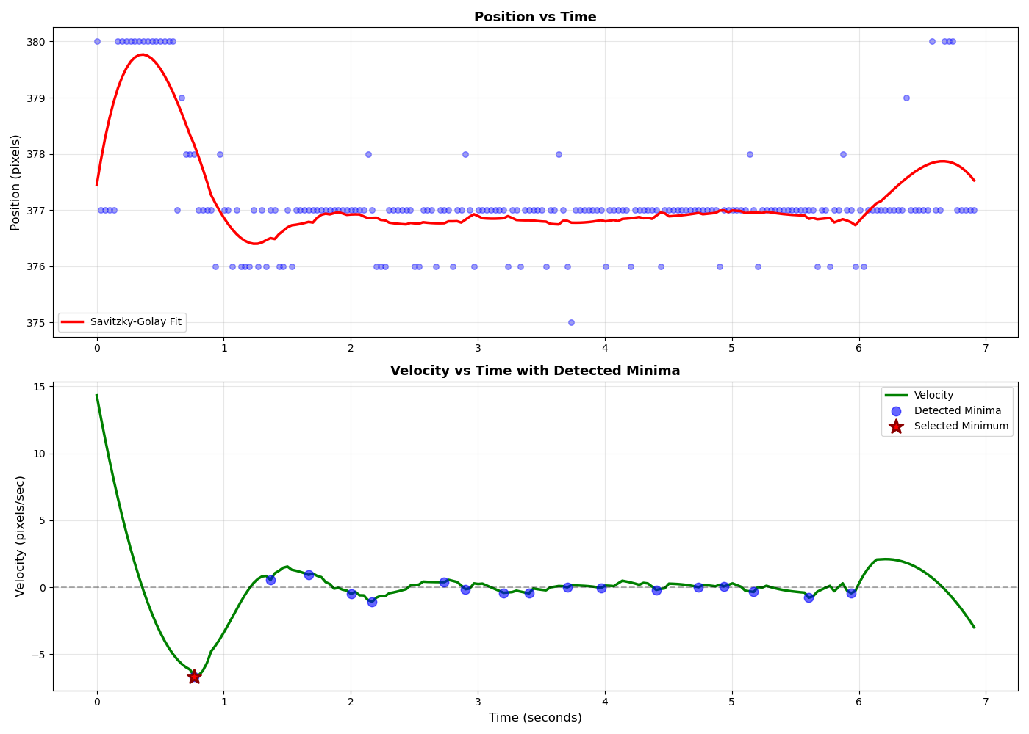
Results
Data analysis
Savitzky-Golay filter was applied with
46 frames (~1.5 s)
polynomial order 3
Velocity vs. time computed from taking the derivative of Position vs. time
Negative velocity minima is selected.
Free bead velocity
Notes:
Velocity need to be calculated from the position time series as the time derivative of position. To obtain smooth velocity estimates and accurate derivatives, a Savitzky-Golay filter was applied to the cleaned position data with a window length of 46 frames (~1.5 seconds) and polynomial order 3.
This filter simultaneously smooths the data and enables accurate computation of the first derivative, yielding the instantaneous velocity at each time point.
The resulting velocity time series represents the flow velocity experienced by the trapped bead and is proportional to the syringe pump flow rate setting.
The negative velocity minima in the derived velocity curve were identified as the points of maximum flow resistance or beam intensity modulation.

Slide 10
Results
Savitzky-Golay filter
By MothNik - Own work, CC0, https://commons.wikimedia.org/w/index.php?curid=164353357
Notes:
The Savitzky-Golay filter is how we extract smooth velocity from noisy position data. The idea is simple — instead of averaging neighboring points, which would blur out real features, we slide a window of fixed width across the time series and fit a low-order polynomial locally at each position.
The center value of that fitted polynomial replaces the raw data point. In our case we used a window of 46 frames — about 1.5 seconds — with a cubic polynomial.
The key advantage here is that because we already have a polynomial fit, we can analytically differentiate it to get velocity directly, without a separate noisy finite-difference step.
The two parameters you tune are the window length — larger means smoother but you lose temporal resolution — and the polynomial order — higher order preserves sharper features but risks overfitting noise.
Our choice of 3 order with a 1.5-second window was a balance: smooth enough to suppress camera noise, but fast enough to still resolve the velocity extrema corresponding to each flow rate change.

Slide 11
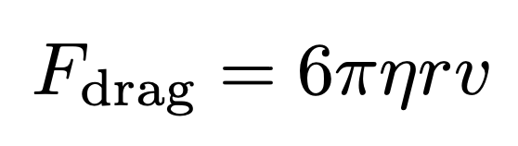
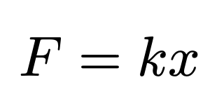
Results
Data analysis
Viscous drag force a trapped bead was calculated using Stokes’ law
η : the dynamic viscosity of water at room temperature
r : bead radius
v : is the measured free-bead velocity at each flow rate
The trap stiffness k was determined by fitting
a linear model to the measured force-displacement pairs across all flow rates:

Slide 12
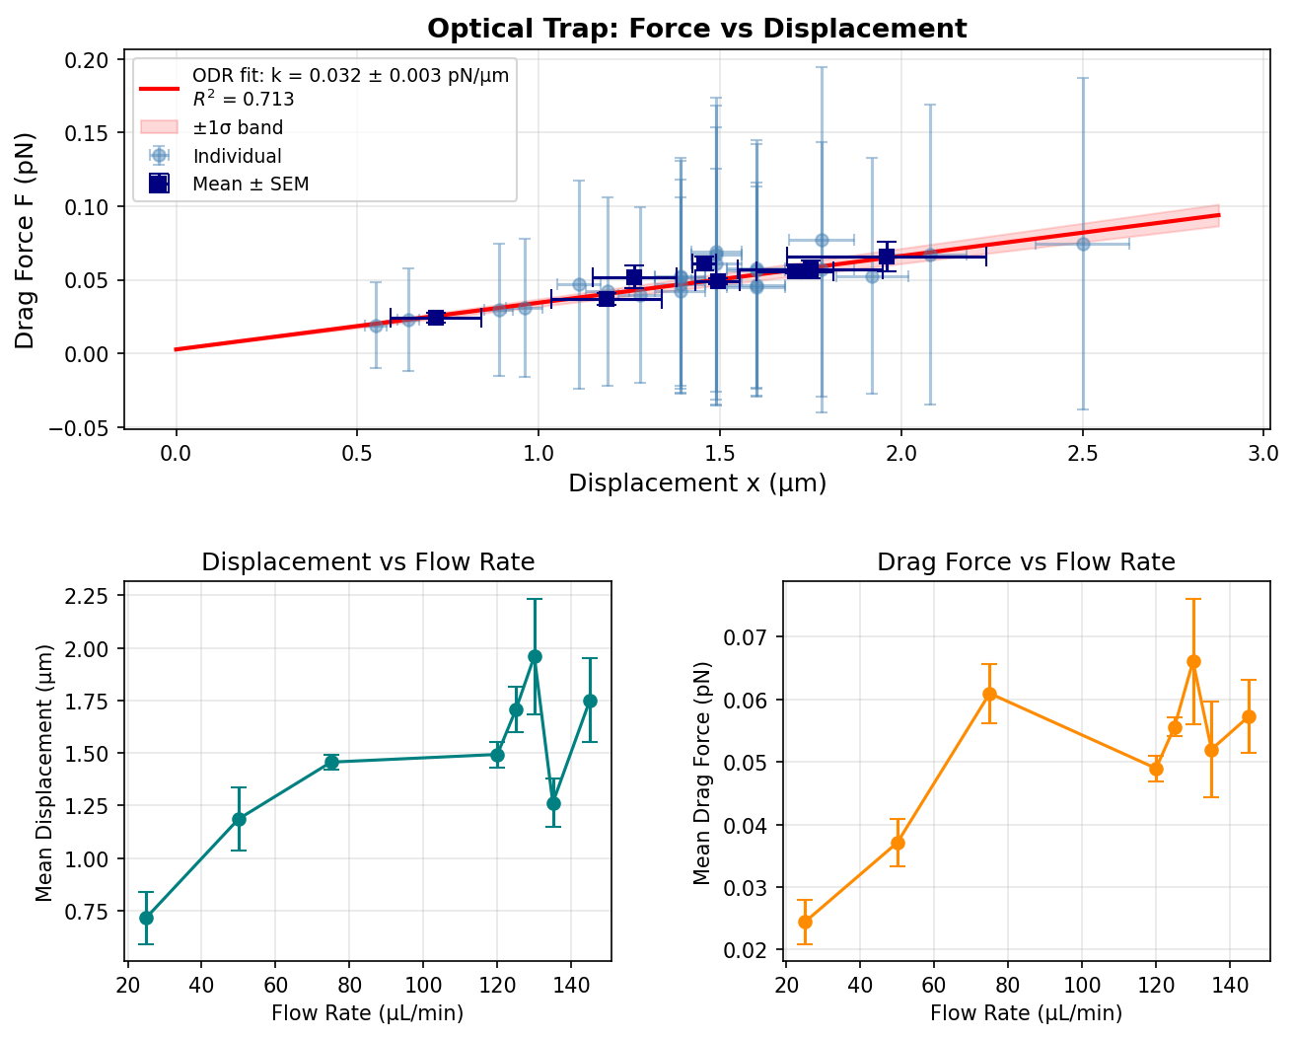
Displacement & Force vs. Flow Rate
(ODR) fit was applied to the force displacement data
1 sigma error band shown in red around ODR.
Displacement is ~ 2 μm and drag force is ~ 0.065 pN at the max flow rate ~ 140 uL/min
Notes:
This linear relationship indicates that the trap follows Hooke's law over the measured range of displacements. The scatter in the data, reflected in 1 sigma error band shown in red, is consistent with measurement uncertainties in both position determination from pixel analysis and flow velocity estimation.
The displacement measurements as a function of flow rate are presented in the left. Mean bead displacement increased with flow rate from approximately 0.7 um at 25 uL/min to 2.0 um at higher flow rates, demonstrating that larger flow-induced forces push the bead further from the trap center.
At the highest flow rates tested (around 140 μL/min), the displacement approached 2 μm, indicating that the trapping force was approaching its maximum capability before bead escape became probable.
The drag force as a function of flow rate is shown in the bottom right. The mean drag force increased from approximately 0.025 pN at the lowest flow rate to a maximum of approximately 0.065~pN at 60 uL/min, followed by a slight decrease and stabilization at higher flow rates.
The maximum drag force measured corresponds to the approximate maximum trapping force that can be sustained before bead escape occurs, setting the upper limit of forces measurable with this optical tweezers configuration.

Slide 13
Conclusion
Successfully calibrated a single-beam optical trap using viscous drag from controlled flow rates
Trap stiffness measured with the R^2 = 0.713; Confirmed Hookean behavior over 0 - 3 um displacement range
Maximum sustainable trapping force ~ 0.065pN, consistent with the laser power and NA used.
All data and analysis pipeline were all uploaded in the GitHub repository https://github.com/Lemon-Elf/PHYS5318.git; branch optical_tweezers

